Slide 1
The Power of Checking Boxes: A Tool for Implementing and Evaluating Holistic Defense
Justine Olderman
Managing Director
Criminal Defense Practice
The Bronx Defenders

Slide 2
Holistic Defense
New model of public defense
Broader that traditional models
Addresses the driving forces of criminal justice involvement
Protects against the collateral consequences of that involvement

Slide 3
Driving Forces
Drug addiction
Alcoholism
Mental illness
Joblessness
Homelessness
Family instability
Poverty

Slide 4
Enmeshed Penalties
Deportation
Eviction
Employment termination/suspension
Loss of child custody, termination of parental rights
Ineligibility for federal student loans
License suspension
Forfeiture and financial consequences

Slide 5
Four Pillars of Holistic Defense
Seamless access to services that meet clients’ legal and social support needs;
Dynamic, interdisciplinary communication;
Advocates with an interdisciplinary skill set;
A robust understanding of, and connection to, the community served.

Slide 6
Implementing Holistic Defense
Located the office in the heart of the community to ensure understanding of and connection to comm.
Hired advocates with an interdisciplinary skill set
Trained criminal defense attorneys to have an interdisciplinary skill set
Created interdisciplinary teams to ensure dynamic communication

Slide 7
Guaranteeing Holistic Defense
What we needed
Equal, consistent, and uniform access to holistic defense regardless of client, case, or advocate
When we needed it
First appearance
How we needed it
Format that was easy to access, simple to use, and quick to complete

Slide 8
Checklist and Guide
Checklist
One page
List of issues
Hints
Guide
When to check the box
What to do at first appearance
What to do immediately afterwards

Slide 9
Phase One - Research
Gathered information on the types of referrals
Collected data on volume of those referrals
Determined the top enmeshed penalties for our client population
Analyzed which enmeshed penalties get triggered at first appearance
Assessed other urgent non-legal needs

Slide 10
Phase Two - Pilot
Piloting
Groups of attys assigned to 1st appearance
Training
Small targeted group sessions
Using pilot attorneys as instructors
Feedback
Weekly feedback sessions with pilot attorneys
Editing
Fine tuned checklist & guide

Slide 11
Phase Three - Full Integration
Made it part of our file folders
Created a way to capture data in our case management system
Created automated reminders for referrals
Created automated e-referral for interdisciplinary advocates

Slide 12
Phase Four - Assessment
Compliance with using checklist
85% of cases have a completed checklist
Identifying the issues
24% of clients have an identified checklist issues at first appearance
Number of referrals made
34% of clients whose case survived first appearances were referred to another advocate

Slide 13
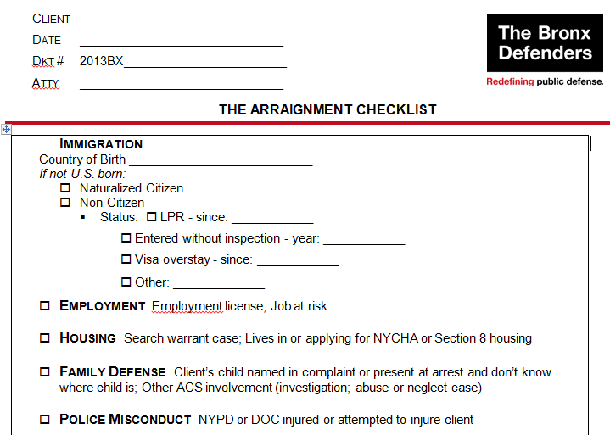
Holistic Checklist

Slide 14
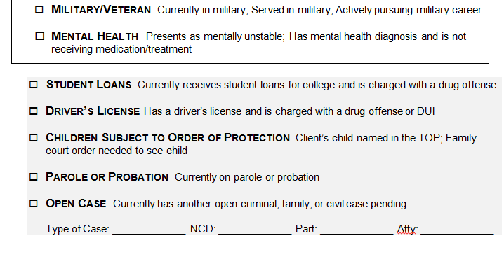
Holistic Checklist

Slide 15
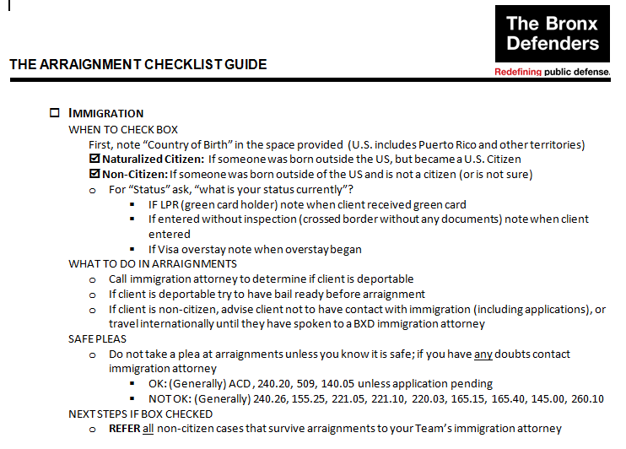
Holistic Checklist Guide

Slide 16
Questions?
Justine Olderman
Managing Director
Criminal Defense Practice
JustineO@BronxDefenders.org
718-838-7878

